Slide 1


PASS Community News
14.11.2019 (RG Bayern)

Slide 2

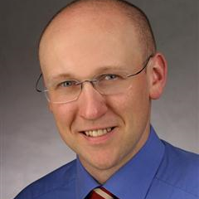

Regional Group Bayern
Your Chapter Leaders
Planned Meetups
Andre Essing aes@sqlpass.de
12.12.2019 Monitoring service quality with artificial intelligence- Alexander Klein
09.01.2020
13.02.2020
12.03.2020
23.04.2020
14.05.2020
18.06.2020
Siegfried Spuddig ssp@sqlpass.de
Erik Monchen emo@sqlpass.de
Updates
PASS Essentials
SQL Saturdays
SQL Konferenz
PASS Camp
Notes:
Principal Software Engineer für SSAS + Power BI

Slide 3
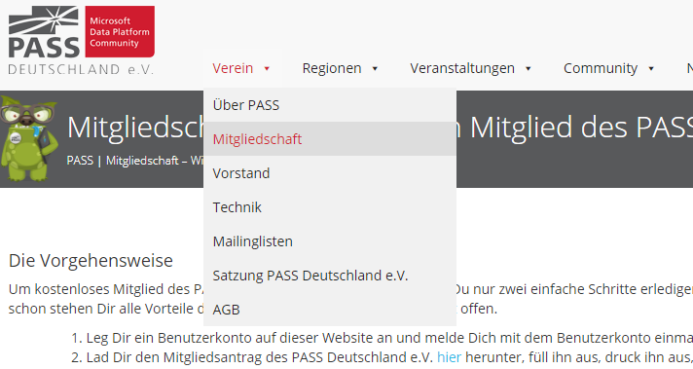
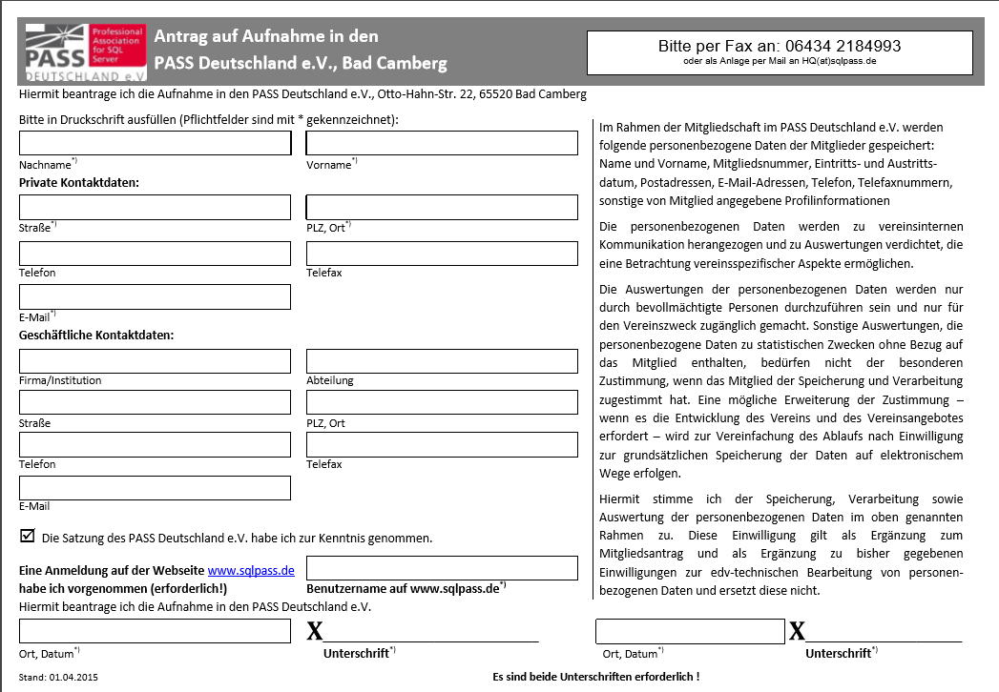
Become a member
Registration on the website since a user account is needed. You have to be logged on at least once.
Download form: "Mitgliedsantrag inkl. Einwilligung gem. BDSG“
Complete the document and send to →
Sign on the left and the right side!
Fax: 06434 2184993 or send a PDF per E-Mail to HQ@sqlpass.de
https://www.sqlpass.de/mitgliedschaft/

Slide 4



PASS on the net & Social Media
www.sqlpass.de
www.facebook.com/SQLPASS.de
www.xing.com/communities/groups/pass-deutschland-c68f-1015046
Twitter: @SQLPASS_de, Hashtag: #SQLPASS_de

Slide 5

Looking for speaker!

Slide 6

PASS Essentials
When | Where | What
11.12.2019 | Bad Camberg | Azure Powershell Scripting für Beginner – Patrick Heyde
19.03.2020 | Neuss | SQL Server Integration Services in der Praxis – Bernd Jungbluth
https://www.sqlpass.de/pass-essentials

Slide 7

PASS Community and other Events
When | Where | What
03. – 05.12.2019 | Seeheim | PASS Camp www.passcamp.de
14.12.2019 | Bonn | Global AI Bootcamp www.globalaibootcamp.com
03. – 05.03.2020 | Darmstadt | SQL Konferenz www.sqlkonferenz.de
28. – 29.05.2020 | Lingen | DataGrillen www.datagrillen.com
xx.05.2020 | St.Augustin | SQL Saturday Rheinland
xx.10.2020 | Munich | SQL Saturday Munich
https://www.sqlpass.de/all-events

Slide 8



Precons now online!
18. Oktober 2019 - http://www.sqlsaturday.com/880
The SQL Server Workshop: SQL 2019, Big Data Clusters, and Azure Data Bob Ward, Buck Woody, Anna Thomas, Benjamin Weissman
Modern Data Warehouse Tillmann Eitelberg, Gabi Münster, Oliver Engels
SQL Server on Linux Benjamin Kettner and Frank Geisler
Power BI Embedded Sample Solution with RLS Access to the on-premise Data Georg Gamsjäger

Slide 9
SQL Saturdays
North America
Europe / Middle East / Africa
Visit www.sqlsaturday.com to register for a event near you!

Slide 10

Thank you!

